Slide 1

Mapping radon in the UK
Summarised by Stephanie Haywood of PHE
Workshop on Expert Judgement for Geographical and Adversarial Problems, Madrid, April 2015
Based on fuller presentation by Zornitza Daraktchieva (PHE) & Antonio Ferreira (BGS)

Slide 2
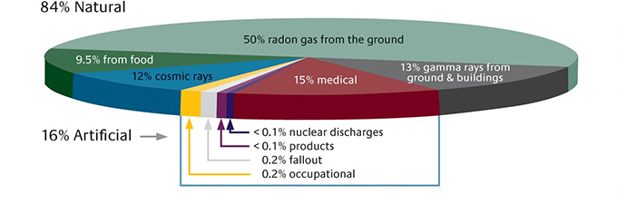
What is radon?
Radon is a colourless, odourless radioactive gas formed by the radioactive decay of the small amounts of uranium that occur naturally in all rocks and soils.
Radon can seep into buildings, through the floor. This is where we get most of our radon exposure.
Indoor radon levels vary - every building contains radon but the levels are usually low. In some areas, homes may have higher levels, and the chances of a higher level depend on the type of ground. For instance, levels may be higher in parts of the country rich in granite, such as Dartmoor in Devon and Cornwall.

Slide 3
Why indoor radon levels vary
Radon enters buildings because of the small pressure difference between indoor and outdoor
Identical houses sitting next to each other could have different geology underneath and different ground conditions (eg cracks or disturbance)
Occupants have different habits (ventilation, average indoor temperature, occupancy patterns)
Mean outdoor temperature varies with season
Wind direction can influence radon ingress
Indoor levels vary between ~ 10 and 20,000 Bq m⁻³

Slide 4
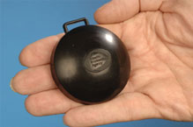
Indoor radon measurements
Two detectors are sent to peoples’ homes by post for 3 months
Results are measured in two occupied rooms called “bedroom” and “living room”
Occupancy factors are used, bedroom (0.55) and living room (0.45)
Radon concentrations are calculated as an average of the two occupied rooms taking into account the occupancy factors
The annual radon concentration is calculated from the above 3 months result using seasonal correction factors
Large numbers of indoor radon measurements are available - more than 500,000 UK homes measured

Slide 5
Uncertainties in estimated annual radon concentrations
Include:
Measurement uncertainties – eg detector response, procedures, human error
Within house spatial uncertainties – eg room usage, and extrapolation of two rooms result to the whole house
Assumption of unchanging people behaviour
3 months measurement is extrapolated to annual result
Measurement of one year is taken as a proxy for every year
House structural changes (eg double glazing, extensions) that affect radon levels
Contribution to indoor radon from radon outdoors and radon emanating from indoor building materials

Slide 6
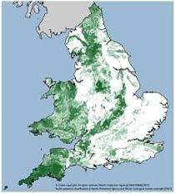
Radon Affected Areas
‘Radon potential’ is the probability of exceeding the Action Level (AL) set at 200 Bq m⁻³
Determined by an estimate of the probability of exceed the AL
Six classes of radon potential: 0-1%, 1-3%, 3-5%, 5-10%, 10-30%, >30 %
Radon affected areas are those where potential is >1% (advice is that homes in these areas should be tested)
The other bands of radon potential support building requirements and targeting of publically funded projects

Slide 7
Want a map for decision-making on radon
Although a large numbers of results are available, not every home is measured (currently ~2% of all UK homes)
Different combinations of surface and bedrock geology will lead to different log-normal distributions of indoor air concentrations
Need to combine indoor radon measurements with geology maps to show probability of exceeding the Action Level (AL) in the UK

Slide 8
DiGMapGB-50 geology is used to map GB
 | Bedrock geology units | Superficial geology units | Map scale
England and Wales | 4,500 grouped to 406 | 892 grouped to 10 | 1:50 000
Scotland | 4,800 grouped to 138 | 189 grouped to 10 | 1:50 000

Slide 9
Methodology
    Uses one of the largest radon data sets in the world ….
    …. in combination with in-depth UK geology data
    Takes account of the number of measurements available in a local area of contiguous geology
    Final map also reflects uncertainties in
        local geological boundaries (most are derived from physical maps)
        uncertainty in allocated house "position"

Slide 10
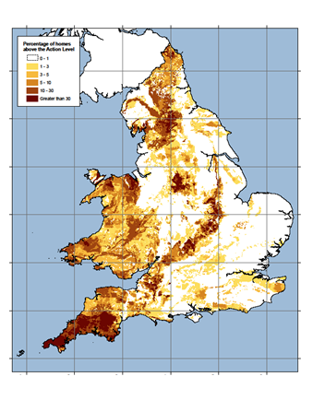
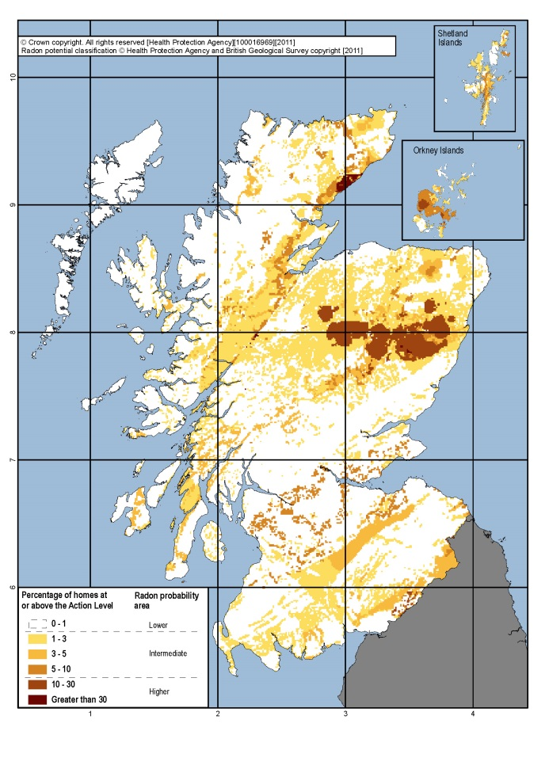
Published indicative maps
England and Wales
Scotland

Slide 11
Web-sites
    http://www.ukradon.org/information/ukmaps/englandwales
    https://publichealthmatters.blog.gov.uk/2015/03/20/five-facts-every-home-owner-should-know-about-radon/
    http://www.ukradon.org/information

