Slide 1
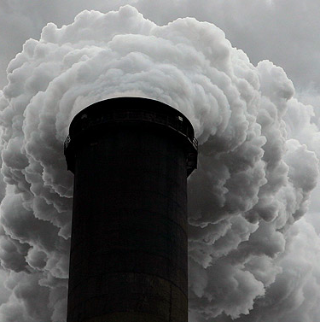
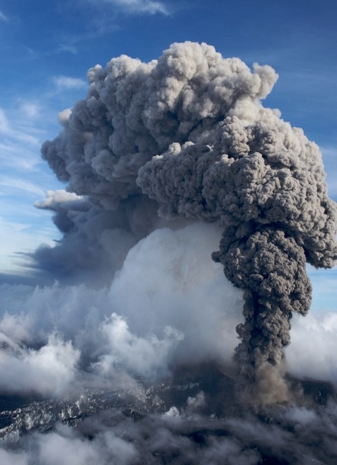
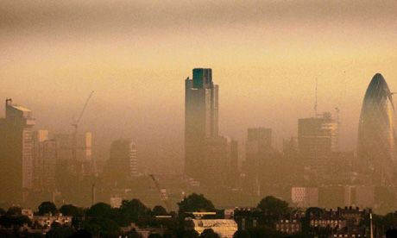

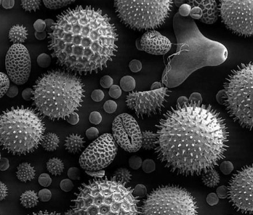

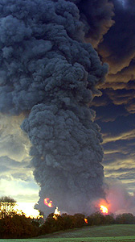
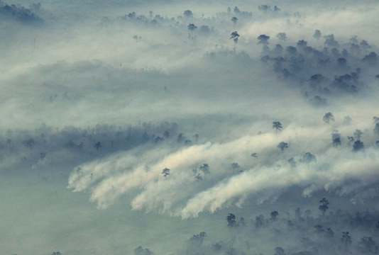
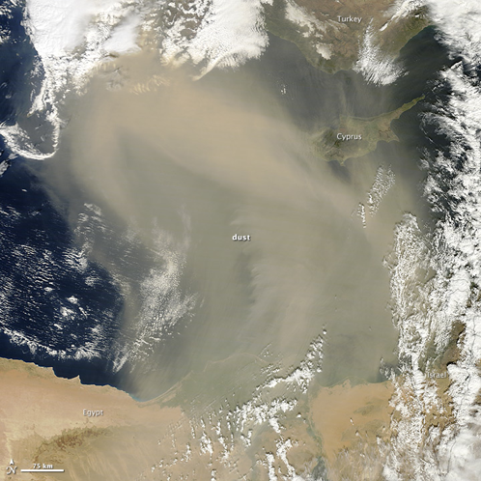
Uncertainty in dispersion predictions
Dr Matthew Hort

Slide 2
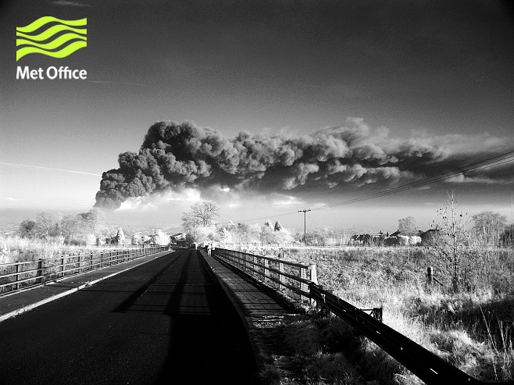
Dispersion Problems and Modelling

Slide 3
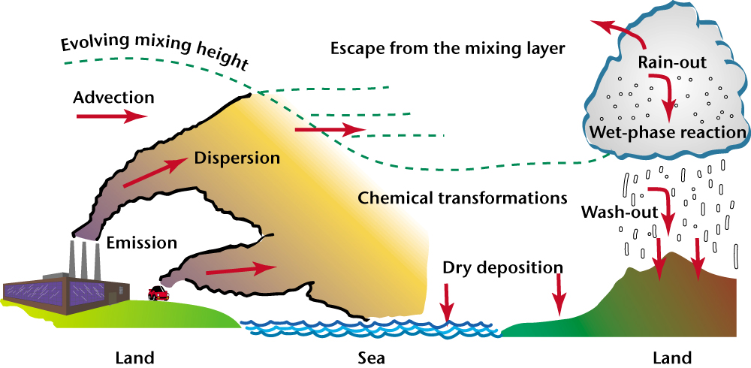
Processes
Convection
Near Source
Radiological
processes
Biological
processes
Micro → Global

Slide 4
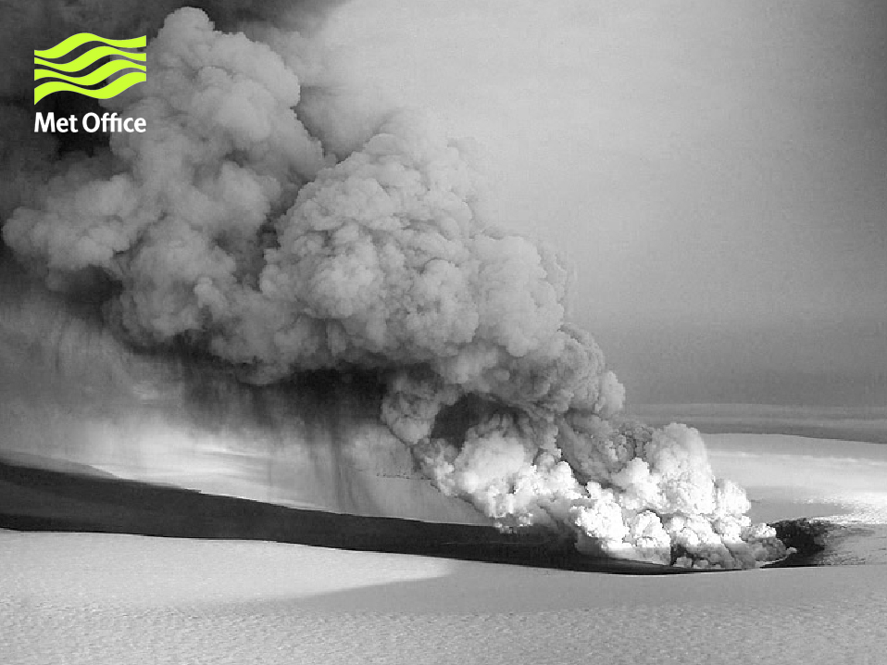
Applications
Vectors
Particulates/Gasses
Volcanic
Industrial
Radiological
Air Quality
Spores/Virus
Biomass burning
Weather
Impacts
Sources
© Crown copyright Met Office
Notes:
4

Slide 5
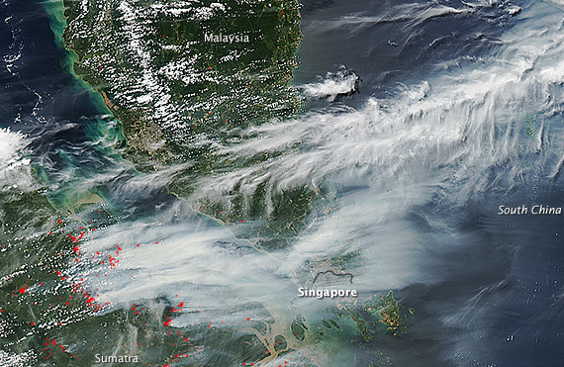
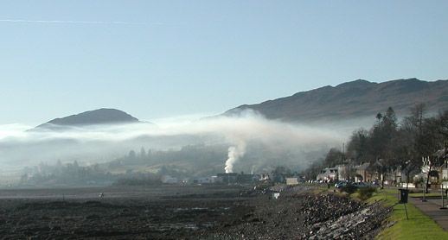
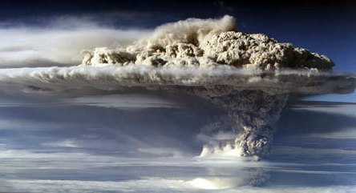
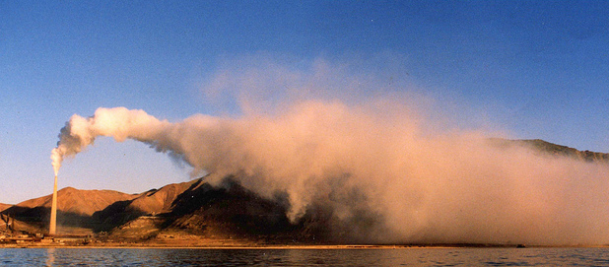
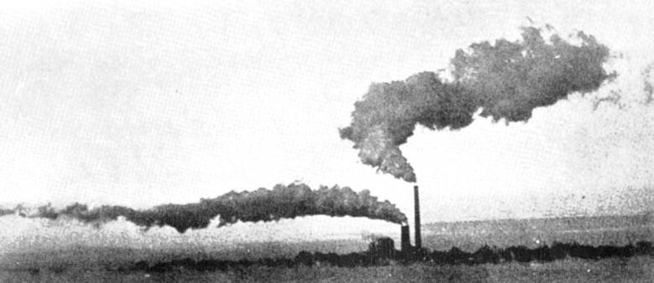
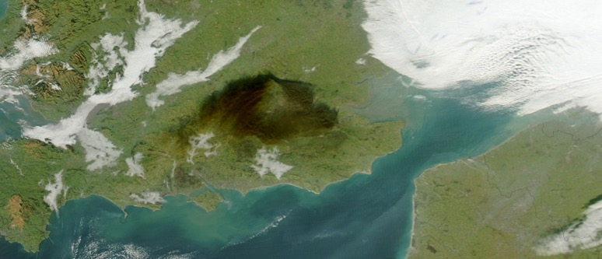
Sources of Uncertainty
Dispersion Predictions

Slide 6
Inputs, processes and Outputs a.k.a. sources of uncertainty
Dispersion
Dilution
Reactions
Coagulation
Decay
Source
Receptor
Particle Size
Exposure Duration
Deposition
Meteorology
Pathway
Losses at source
Reactions
Transport
Numbers
Fluctuations
Total Exposure
Buoyancy
Environment
Human
Species
Altitude
Location
Amount
Duration
Response Rate
TIME
Notes:
Detailed Chain

Slide 7
METEOROLOGY

Slide 8
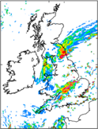
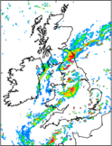
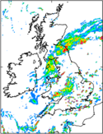
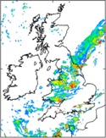
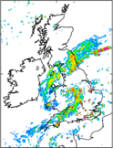
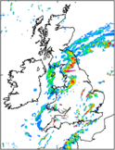
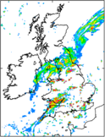
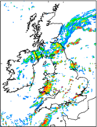
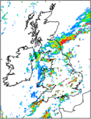
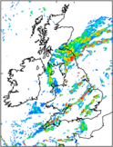
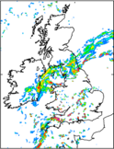
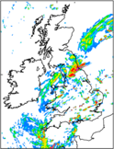
Ensembles
Capturing some of the uncertainty the ensemble
Deterministic
Forecast
Initial Condition Uncertainty
Analysis
time
Forecast uncertainty

Slide 9
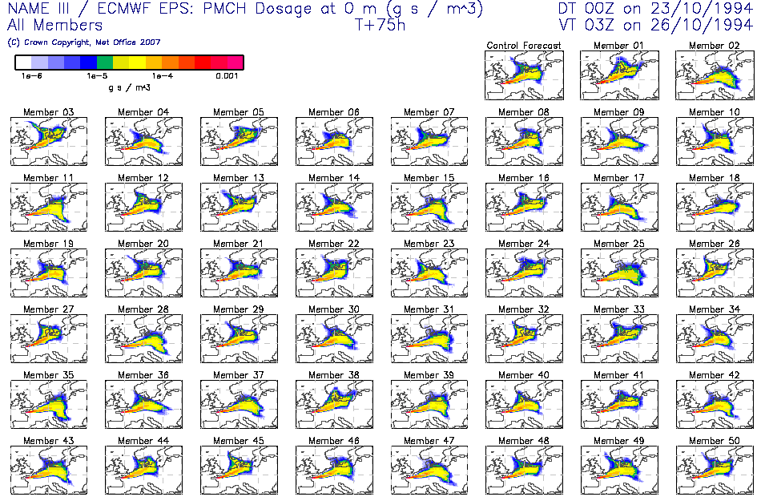
EPS-based dispersion modelling

Slide 10
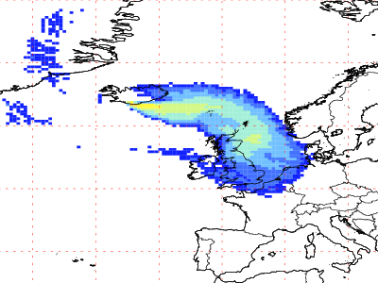
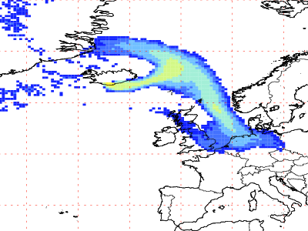
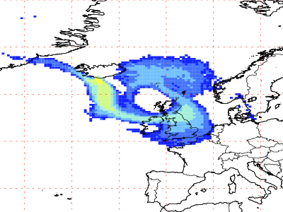
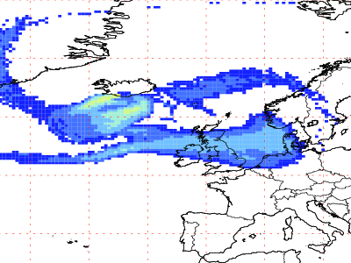
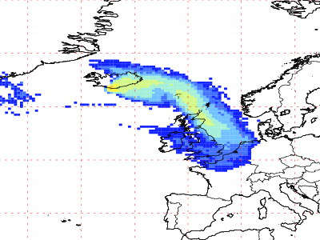
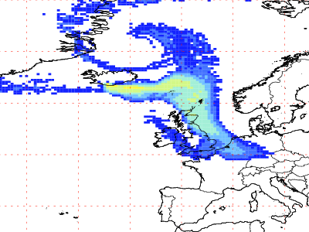
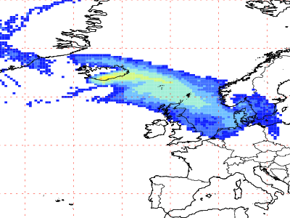
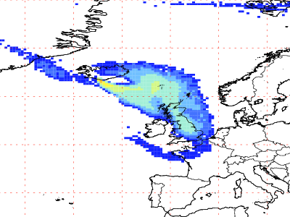
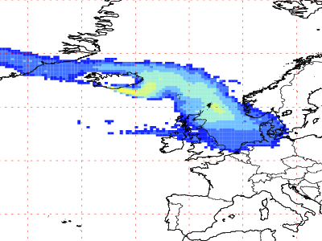
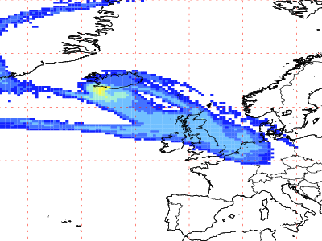
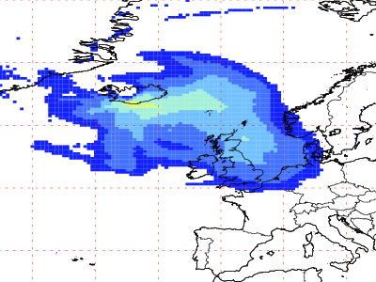
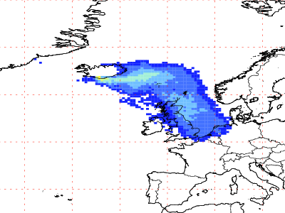
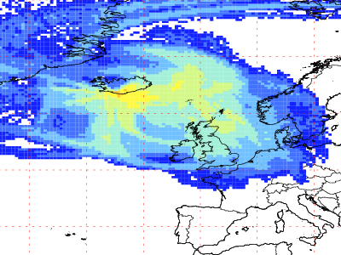
NAME Predictions
Using ECMWF EPS forecasts
Mean
50th percentile
100th percentile

Slide 11
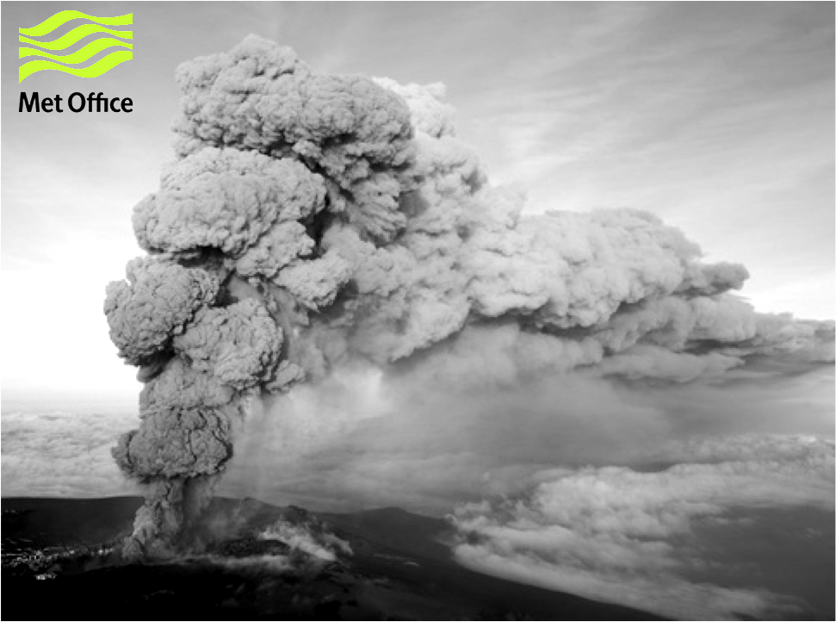
Emissions

Slide 12
Volcanic Eruptions
Source term uncertainty
Documented Hazard
  e.g. Laki 1783, Galunggung 1982, Eyja 2010, etc
Source term uncertainty
  Mass (gas and/or ash)
  Ash size, density, shape
  Height, timing
  Water
  etc
Many other sources of uncertainty as well

Slide 13
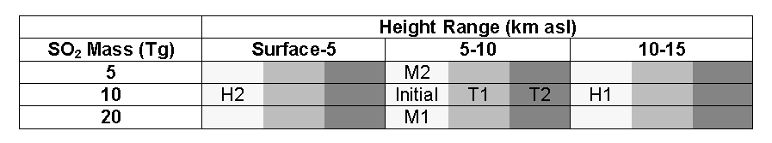
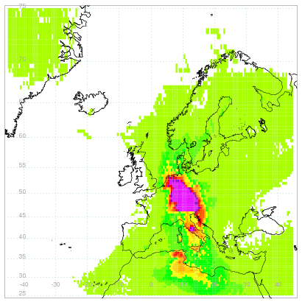
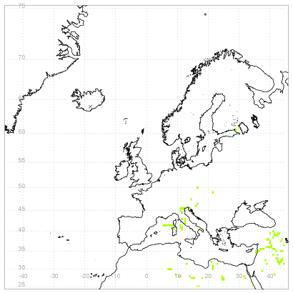
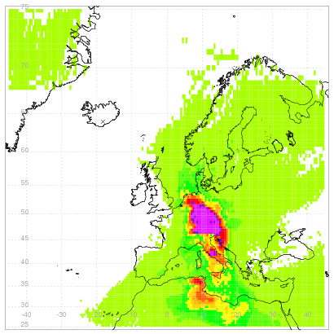
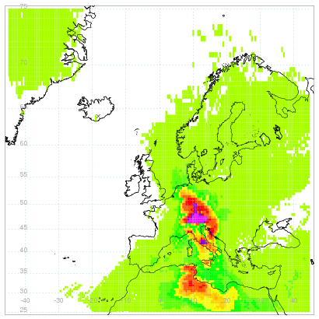
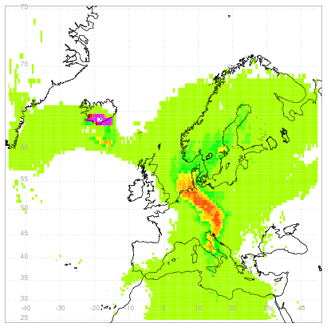
Volcanic Gas
Near surface SO₂
6hr 12 24
Initial
H1
T1
H2
T2

Slide 14
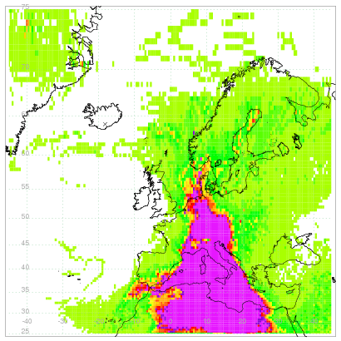

Volcanic Gas
Near surface SO₄
Initial
H2
(low emission height)
All other scenarios have a similar distribution to the initial
Notes:
All others similar to initial

Slide 15


Detail
Near-surface maximum concentrations (μg/m³)
Factor of 8.5
Including these:
Factor of 500+; Factor of 200
Factor of 4. Factor of 32
Maximum duration above threshold at surface
Factor of ~4 difference in max duration at moderate.
Longest duration is ~9 days

Slide 16

Dispersion Processes

Slide 17






Fukushima
Deposition prediction
Deposition dependent on
  Precipitation
    Type
    Rate
  Cloud (frozen or liquid)
  Contaminant properties – state, particle size, hygroscopicity
  Timing and relative position
Widely varying formulations and values in literature
In-cloud
(Rainout)
Below-cloud
(Washout)

Slide 18



Fukushima
Modelled - Masked
Cs137 Deposits - Modelled
k Bq/m²
Modelled - Unmasked

Slide 19


Deposits
Model - Observations
Scavenging coefficient
k Bq/m²

Slide 20
Statistical Comparison

Slide 21
Thoughts
Layers of uncertainty
Most un-quantified
Event, impact and end user can:
  change relative significance of uncertainties
  require different information
Presentation
  complex
  unclear how best to deal with

